Slide 1

CS654: Digital Image Analysis
Lecture 30: Clustering based Segmentation
Slides are adapted from: http://www.wisdom.weizmann.ac.il/~vision/

Slide 2
Recap of Lecture 26
Thresholding
Otsu’s method
Region based segmentation
Region growing, split-merge, quad-tree
Clustering, K-means

Slide 3
Outline of Lecture 27
Overview about Mean Shift Segmentation
Mean Shift algorithm
Kernel density estimation
Kernel
Mean shift segmentation
Applications of Mean Shift
Clustering
Filtering

Slide 4
Segmentation methods – overview
Edge based
Thresholding
K-means clustering
The k-means algorithm is an algorithm to cluster n objects based on attributes into k partitions, k < n
Mean-shift algorithm
Normalized cuts

Slide 5
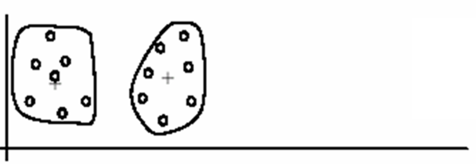
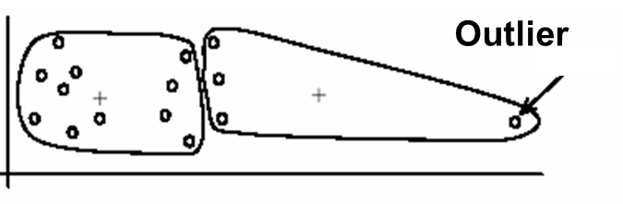
K-Means pros and cons
Pros
Simple and fast
Easy to implement
Cons
Need to choose K
Sensitive to outliers

Slide 6
Mean-shift – motivation and intuitive description
Given a distribution of points, mean shift is a procedure for finding the densest region.
Example for simple 2D case
Start from arbitrary point in the distribution
Region of interest is a circle centered in this point
On each iteration find the center of the mass for the region of interest
Move the circle to the center of the mass
Continue the iterations until convergence

Slide 7
Intuitive Description
Region of
interest
Center of
mass
Mean Shift
vector
Distribution of identical billiard balls
Objective : Find the densest region

Slide 8
Intuitive Description
Region of
interest
Center of
mass
Mean Shift
vector
Distribution of identical billiard balls
Objective : Find the densest region

Slide 9
Intuitive Description
Region of
interest
Center of
mass
Mean Shift
vector
Distribution of identical billiard balls
Objective : Find the densest region

Slide 10
Intuitive Description
Region of
interest
Center of
mass
Mean Shift
vector
Distribution of identical billiard balls
Objective : Find the densest region

Slide 11
Intuitive Description
Region of
interest
Center of
mass
Mean Shift
vector
Distribution of identical billiard balls
Objective : Find the densest region

Slide 12
Intuitive Description
Region of
interest
Center of
mass
Mean Shift
vector
Distribution of identical billiard balls
Objective : Find the densest region

Slide 13
Intuitive Description
Region of
interest
Center of
mass
Distribution of identical billiard balls
Objective : Find the densest region

Slide 14
Mean-shift – algorithm formal definition
The Basic Mean Shift Algorithm is formulated according to the following paper:
D. Comaniciu, P. Meer: Mean Shift Analysis and Applications, IEEE Int. Conf. Computer Vision (ICCV'99), Kerkyra , Greece , 1197-1203, 1999

Slide 15
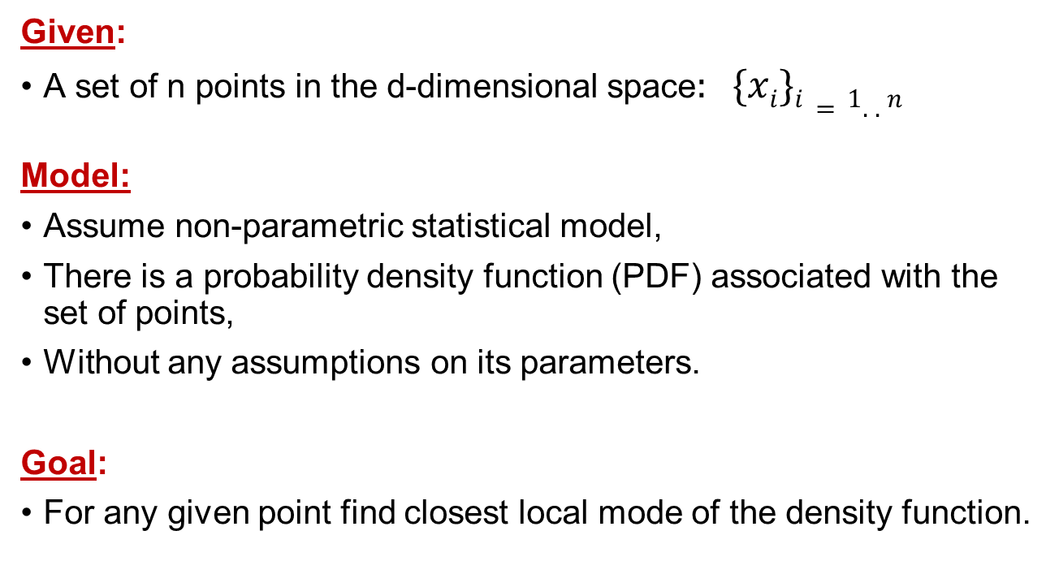
Mean-shift – algorithm formal definition
Given:
A set of n points in the d-dimensional space$: \{xi\}i=1..n$
Model:
Assume non-parametric statistical model,
There is a probability density function (PDF) associated with the set of points,
Without any assumptions on its parameters.
Goal:
For any given point find closest local mode of the density function.

Slide 16
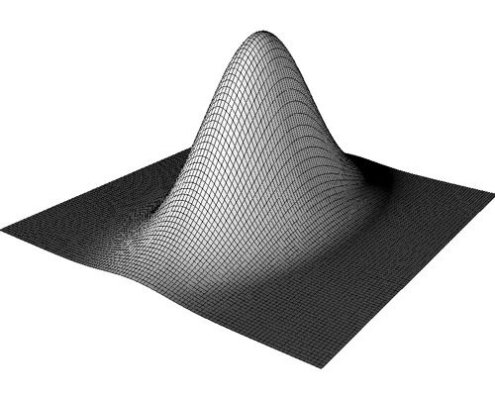
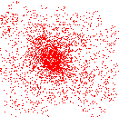
What is Mean Shift ?
A tool for:
Finding modes in a set of data samples, manifesting an
underlying probability density function (PDF) in R^{N}
PDF in feature space
Color space
Scale space
Actually any feature space you can conceive
…
Non-parametric
Density Estimation
Discrete PDF Representation
Data
Non-parametric
Density GRADIENT Estimation
(Mean Shift)
PDF Analysis

Slide 17
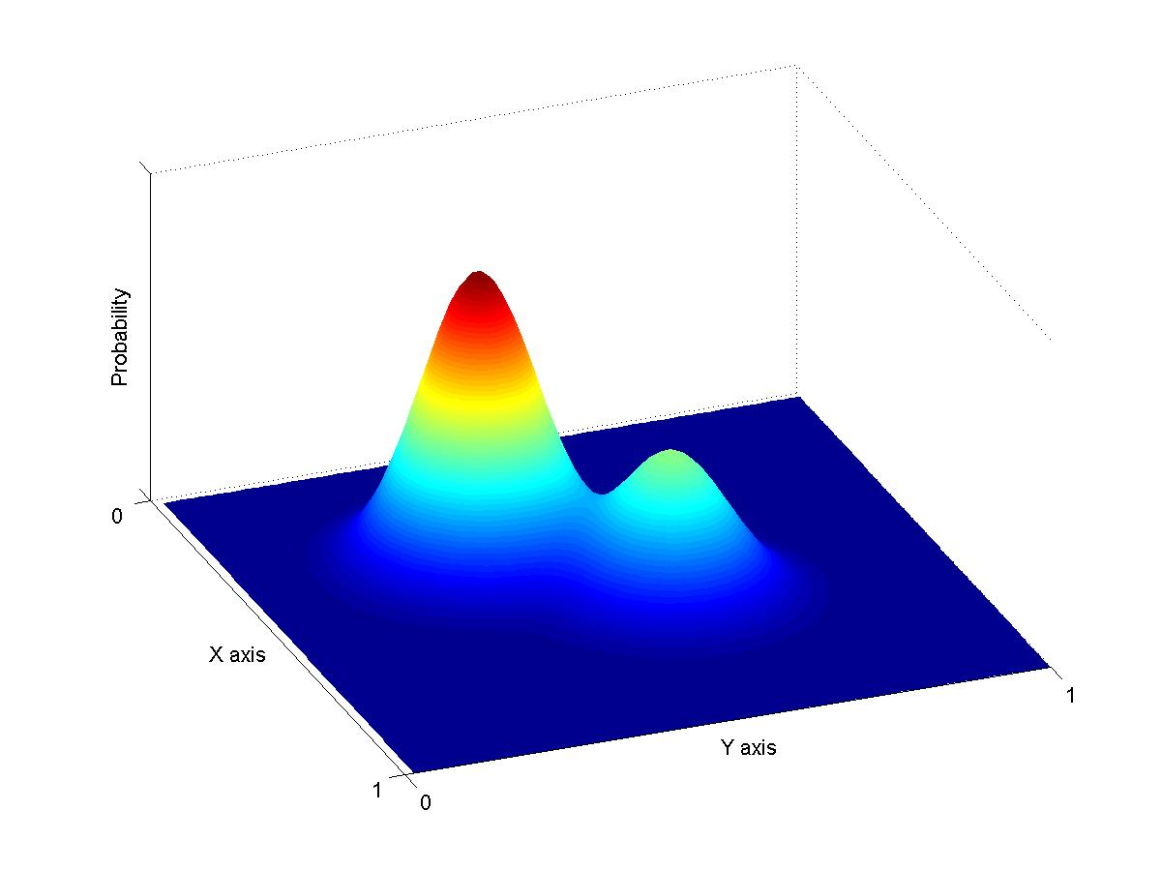
Non-Parametric Density Estimation
Assumption : The data points are sampled from an underlying PDF
Data point density
implies PDF value !
Assumed Underlying PDF
Real Data Samples

Slide 18
Non-Parametric Density Estimation
Assumed Underlying PDF
Real Data Samples

Slide 19
Non-Parametric Density Estimation
Assumed Underlying PDF
Real Data Samples

Slide 20
Parametric Density Estimation
Assumption : The data points are sampled from an underlying PDF
Estimate
Assumed Underlying PDF
Real Data Samples

Slide 21
Kernel Density Estimation
Parzen Windows - Function Forms
A function of some finite number of data points
x₁…x_{n}
Data
In practice one uses the forms:
Profile
or
Same function on each dimension
Function of vector length only

Slide 22
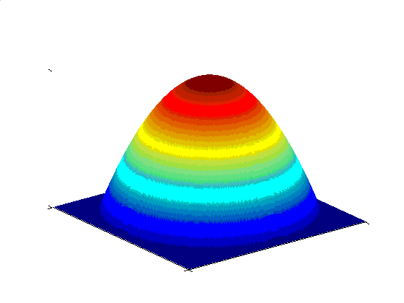
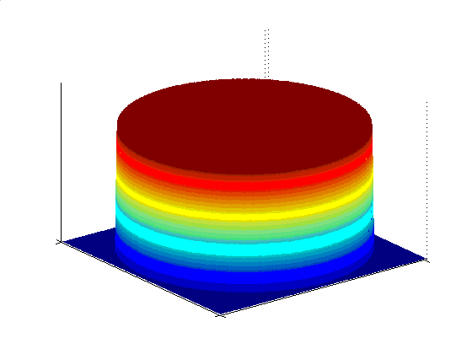
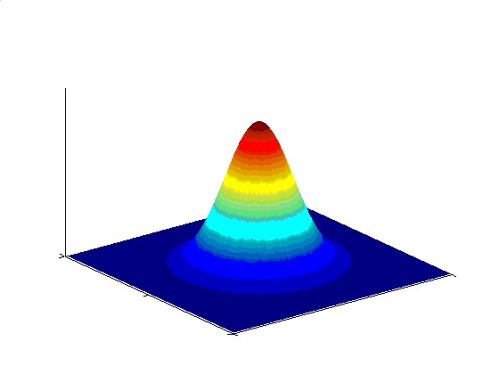
Various Kernels
A function of some finite number of data points
x₁…x_{n}
Examples:
Epanechnikov Kernel
Uniform Kernel
Normal Kernel
Data

Slide 23
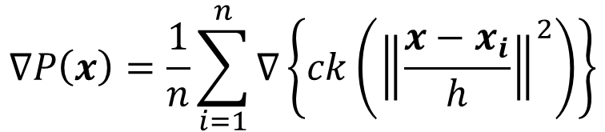
Kernel Density Estimation
Gradient
Give up estimating the PDF !
Estimate ONLY the gradient
Using the
Kernel form:
Size of window
$$∇P\left(x\right)=\frac{1}{n}\sum_{i=1}^{n}{∇\left\{ck\left({\left\|\frac{x−x_{i}}{h}\right\|}^{2}\right)\right\}}$$

Slide 24
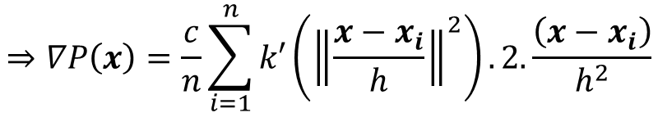
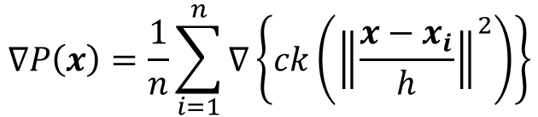
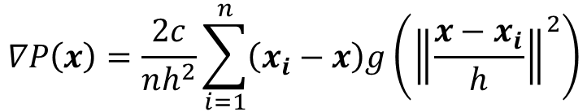
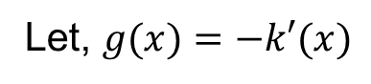
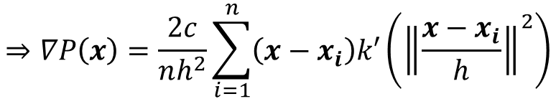
Kernel Density Gradient Estimation
$$∇P\left(x\right)=\frac{1}{n}\sum_{i=1}^{n}{∇\left\{ck\left({\left\|\frac{x−x_{i}}{h}\right\|}^{2}\right)\right\}}$$
$$⇒∇P\left(x\right)=\frac{c}{n}\sum_{i=1}^{n}{k′}\left({\left\|\frac{x−x_{i}}{h}\right\|}^{2}\right).2.\frac{\left(x−x_{i}\right)}{h^{2}}$$
$$⇒∇P\left(x\right)=\frac{2c}{nh^{2}}\sum_{i=1}^{n}{\left(x−x_{i}\right)k′}\left({\left\|\frac{x−x_{i}}{h}\right\|}^{2}\right)$$
Let, $g(x)=−k′(x)$
$$∇P\left(x\right)=\frac{2c}{nh^{2}}\sum_{i=1}^{n}{\left(x_{i}−x\right)g}\left({\left\|\frac{x−x_{i}}{h}\right\|}^{2}\right)$$

Slide 25
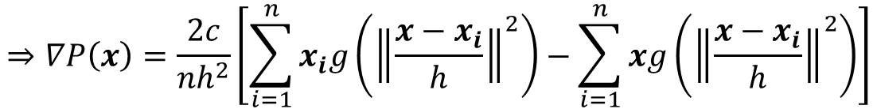
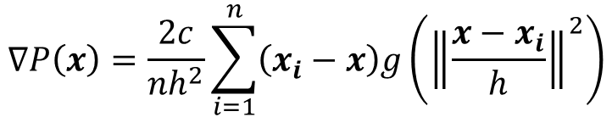
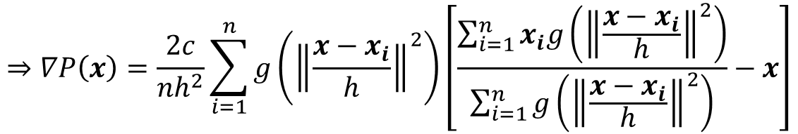
Kernel Density Gradient Estimation
$$∇P\left(x\right)=\frac{2c}{nh^{2}}\sum_{i=1}^{n}{\left(x_{i}−x\right)g}\left({\left\|\frac{x−x_{i}}{h}\right\|}^{2}\right)$$
$$⇒∇P\left(x\right)=\frac{2c}{nh^{2}}\left[\sum_{i=1}^{n}{x_{i}g}\left({\left\|\frac{x−x_{i}}{h}\right\|}^{2}\right)−\sum_{i=1}^{n}{xg}\left({\left\|\frac{x−x_{i}}{h}\right\|}^{2}\right)\right]$$
$$⇒∇P\left(x\right)=\frac{2c}{nh^{2}}\sum_{i=1}^{n}{g}\left({\left\|\frac{x−x_{i}}{h}\right\|}^{2}\right)\left[\frac{\sum_{i=1}^{n}{x_{i}g}\left({\left\|\frac{x−x_{i}}{h}\right\|}^{2}\right)}{\sum_{i=1}^{n}{g}\left({\left\|\frac{x−x_{i}}{h}\right\|}^{2}\right)}−x\right]$$

Slide 26
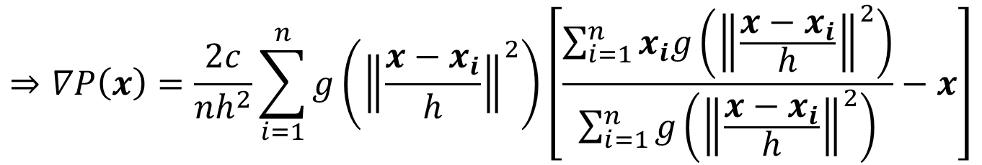
Computing the Mean Shift
$$⇒∇P\left(x\right)=\frac{2c}{nh^{2}}\sum_{i=1}^{n}{g}\left({\left\|\frac{x−x_{i}}{h}\right\|}^{2}\right)\left[\frac{\sum_{i=1}^{n}{x_{i}g}\left({\left\|\frac{x−x_{i}}{h}\right\|}^{2}\right)}{\sum_{i=1}^{n}{g}\left({\left\|\frac{x−x_{i}}{h}\right\|}^{2}\right)}−x\right]$$
Yet another Kernel
density estimation !
Simple Mean Shift procedure:
Compute mean shift vector
Translate the Kernel window by m(x)

Slide 27
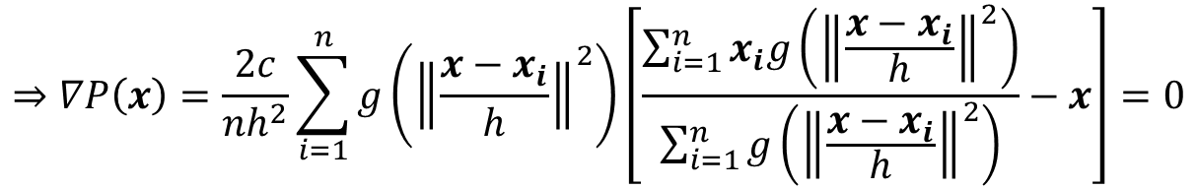
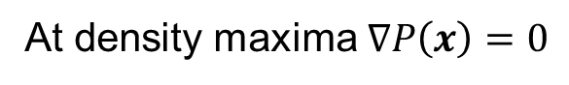
Mean Shift Procedure
At density maxima $∇P\left(x\right)=0$
$$⇒∇P\left(x\right)=\frac{2c}{nh^{2}}\sum_{i=1}^{n}{g}\left({\left\|\frac{x−x_{i}}{h}\right\|}^{2}\right)\left[\frac{\sum_{i=1}^{n}{x_{i}g}\left({\left\|\frac{x−x_{i}}{h}\right\|}^{2}\right)}{\sum_{i=1}^{n}{g}\left({\left\|\frac{x−x_{i}}{h}\right\|}^{2}\right)}−x\right]=0$$
mean shift vector — must be 0 at optimum

Slide 28
Mean Shift Properties
Automatic convergence speed – the mean shift vector size depends on the gradient itself.
Near maxima, the steps are small and refined
Convergence is guaranteed for infinitesimal steps only ➔ infinitely convergent, (therefore set a lower bound)
For Uniform Kernel ( ), convergence is achieved in a finite number of steps
Normal Kernel ( ) exhibits a smooth trajectory, but is slower than Uniform Kernel ( ).
Adaptive
Gradient
Ascent

Slide 29
Real Modality analysis
Tessellate the space with windows
Run the procedure in parallel

Slide 30
Attraction basin
Capture theorem
Attraction basin:
The region for which all trajectories lead to the same mode
Cluster: all data points in the attraction basin of a mode

Slide 31
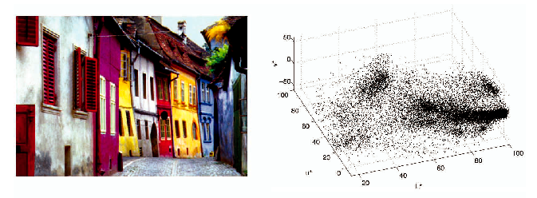
Clustering: Real Example
L*u*v space representation

Slide 32
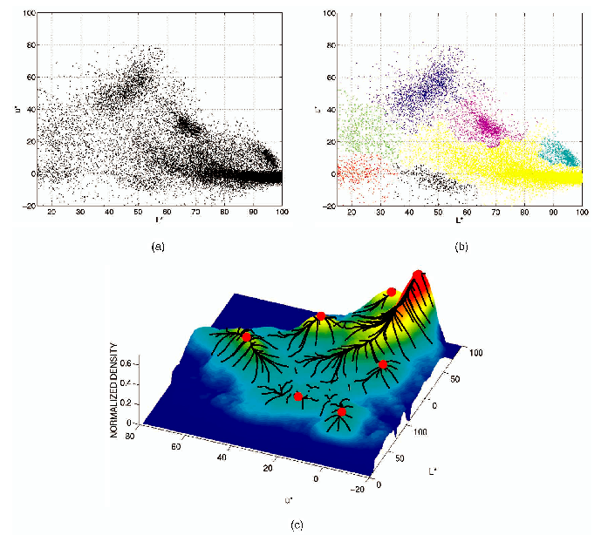
Clustering: Real Example
2D (L*u) space representation
Final clusters
Not all trajectories
in the attraction basin
reach the same mode

Slide 33
Mean shift clustering
The mean shift algorithm seeks modes of the given set of points
Choose kernel and bandwidth
For each point:
Center a window on that point
Compute the mean of the data in the search window
Center the search window at the new mean location
Repeat (b,c) until convergence
Assign points that lead to nearby modes to the same cluster

Slide 34
Segmentation by Mean Shift
Feature space : Joint domain = spatial coordinates + color space
Find features (color, gradients, texture, etc)
Set kernel size for features K_{r} and position K_{s}
Initialize windows at individual pixel locations
Perform mean shift for each window until convergence
Merge windows that are within width of K_{r} and K_{s}

Slide 35
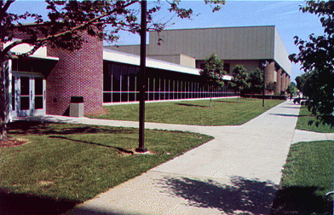
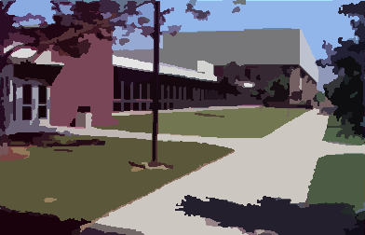
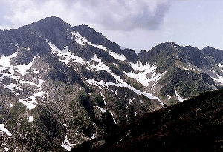
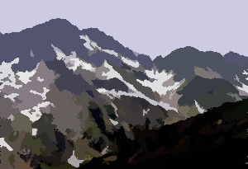
Mean shift segmentation results
http://www.caip.rutgers.edu/~comanici/MSPAMI/msPamiResults.html

Slide 36
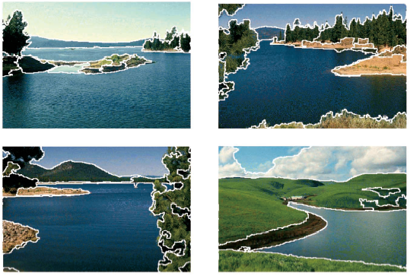
Mean shift segmentation results
http://www.caip.rutgers.edu/~comanici/MSPAMI/msPamiResults.html

Slide 37
Application of Mean Shift: Filtering
Image filtering is a process by which we can enhance, modify or multilate images.
Filtering reduces the influence from noise to mode detection.
Mean shift filtering can work with binary, gray scale, RGB and arbitrary multichanel images.
Filtering is the first step of mean shift segmentation process.
A second step is the clustering of filtered data point

Slide 38
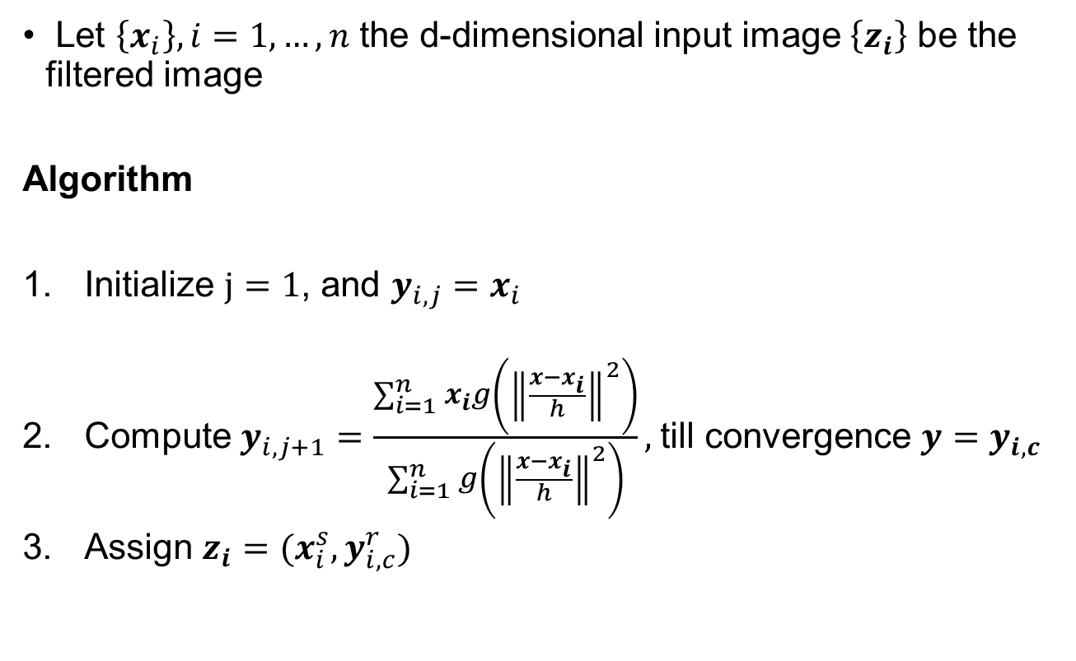
Mean Shift Filtering
Let $\left\{x_{i}\right\},i=1,…, n$ the d-dimensional input image $\left\{z_{i}\right\}$ be the filtered image
Algorithm
Initialize $j=1$, and $y_{i,j}=x_{i}$
Compute $y_{i,j+1}=\frac{\sum_{i=1}^{n}{x_{i}g}\left({\left\|\frac{x−x_{i}}{h}\right\|}^{2}\right)}{\sum_{i=1}^{n}{g}\left({\left\|\frac{x−x_{i}}{h}\right\|}^{2}\right)},$till convergence $y=y_{i,c}$
Assign $z_{i}=(x_{i}^{s},y_{i,c}^{r})$
Spatial location $x_{i}$ will have range component of the point of convergence

Slide 39
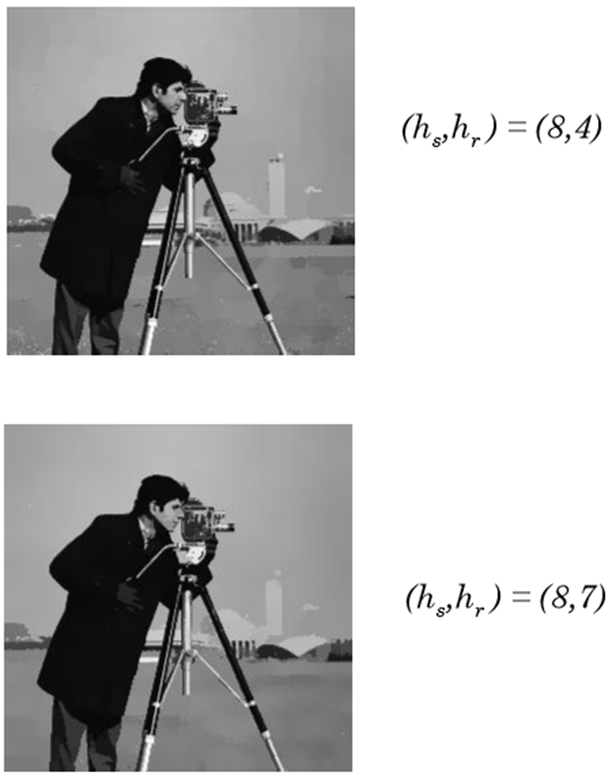

Examples

Slide 40
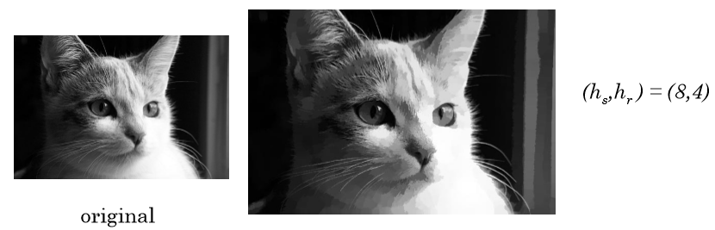
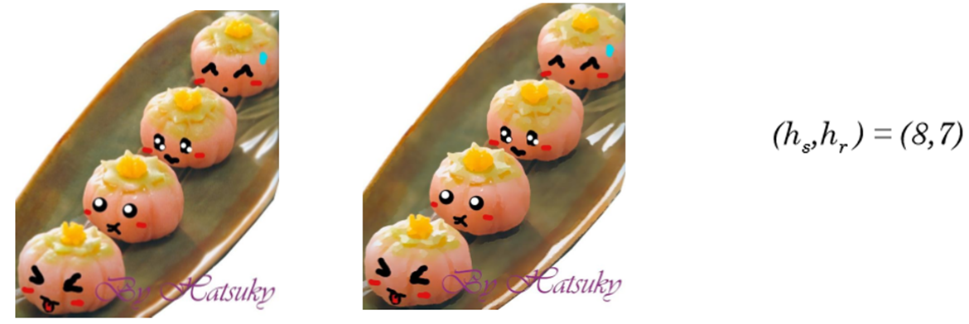
Examples

Slide 41
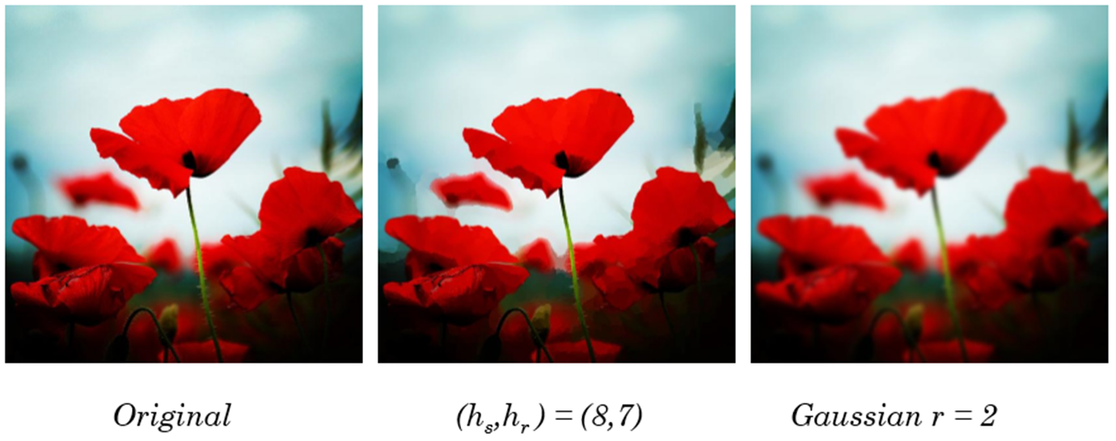
Comparison with Gaussian

Slide 42
Mean-shift: other issues
Speedups
Uniform kernel (much faster but not as good)
Binning or hierarchical methods
Approximate nearest neighbor search
Methods to adapt kernel size depending on data density

Slide 43
Mean shift pros and cons
Pros
Good general-practice segmentation
Finds variable number of regions
Robust to outliers
Cons
Have to choose kernel size in advance
Original algorithm doesn’t deal well with high dimensions
When to use it
Over-segmentatoin
Multiple segmentations
Other tracking and clustering applications

Slide 44
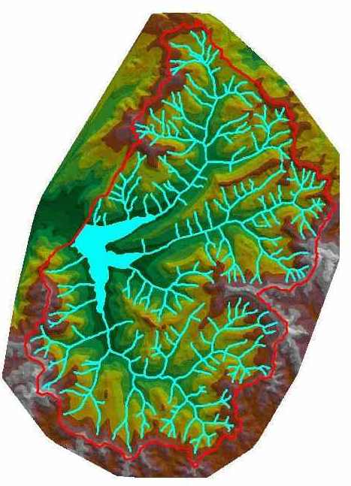
Watershed algorithm

Slide 45

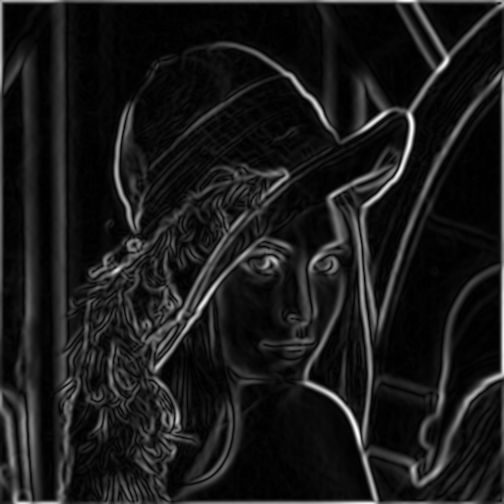
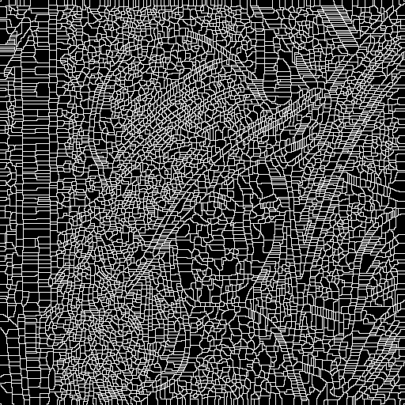
Watershed segmentation
Image
Gradient
Watershed boundaries

Slide 46
Meyer’s watershed segmentation
Choose local minima as region seeds
Add neighbors to priority queue, sorted by value
Take top priority pixel from queue
If all labeled neighbors have same label, assign to pixel
Add all non-marked neighbors
Repeat step 3 until finished
Matlab: seg = watershed(bnd_im)

Slide 47
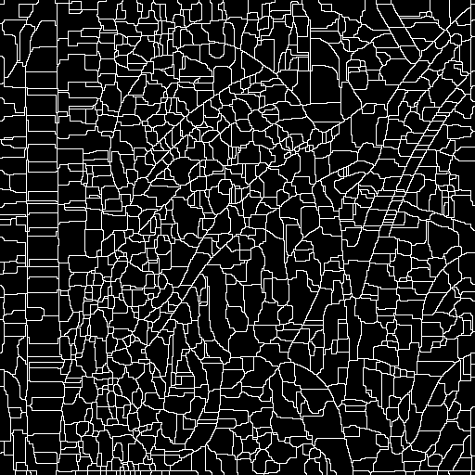
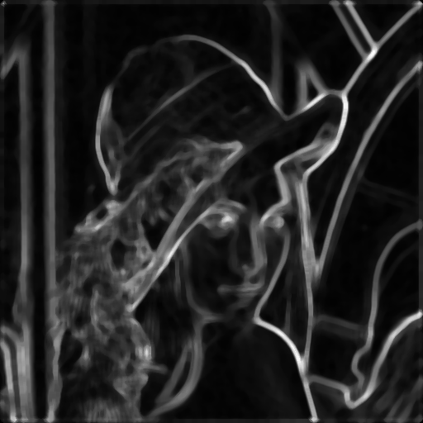
Simple trick
Use median filter to reduce number of regions

Slide 48
Watershed pros and cons
Pros
Fast (< 1 sec for 512x512 image)
Among best methods for hierarchical segmentation
Cons
Only as good as the soft boundaries
Not easy to get variety of regions for multiple segmentations
No top-down information
Usage
Preferred algorithm for hierarchical segmentation

Slide 49
Thank you
Next Lecture: Graph based approach

